Slide 1

CSE291- Introduction to Software Engineering (FALL 2022)
Lecture 4
Software Process and Process Models

Slide 2
Objectives
Evolutionary Models
Exploratory
Prototyping
Component Based Software Engineering
Iterative Models
Incremental Model
Spiral Model

Slide 3
Evolutionary Models
Evolutionary Development:
Includes the activities of specification, development and validation
Initial system is developed from abstract specification
Then refined with customer input to produce a system that satisfies the customer’ s needs.
Two types of evolutionary development
Exploratory
Prototyping

Slide 4
Evolutionary Models
Exploratory Model
Objective of the process is to work with customers to explore their requirements and deliver a final system.
The development starts with the parts of the system that are understood.
The system evolves by adding new features proposed by customer.
This model works best in situations where few, or none, of the system or product requirements are known in detail.

Slide 5
Exploratory Models
Specification
Initial Version
Outline Description
Intermediate Version
Development
Validation
Final
Version

Slide 6
Exploratory Model
Problems:
Lack of process visibility
Systems are often poorly structured
Applicability:
For small or medium-size interactive systems
For parts of large systems (e.g. the user interface)

Slide 7
Evolutionary Models
Prototyping Model
When a customer defines a set of general objectives for a software but does not identify detailed I/O or processing requirements.
A prototype is built to understand the requirements.
By using this prototype, the client can get an “actual feel” of the system
The interactions with prototype can enable the client to better understand the requirements of the desired system
Prototyping is an attractive idea for complicated and large systems.

Slide 8
Evolutionary Models
Prototyping Model
Consists of 4 iterating phases:
Requirements gathering.
Design and build prototype.
Evaluate prototype with customer.
Refine requirements.

Slide 9
Prototype Model
1. Requirements gathering.
2. Design and build SW prototype.
3. Evaluate prototype with customer.
4. Refine requirements.
1 / 4
Listen to Customer
2
Build / Revise prototypes
3
Customer Test-Drives prototypes

Slide 10
Prototyping
Engineer
Product
Requirements
No
Quick
Design
Yes
Changes?
Build
Prototype
Refine
Prototype
Evaluate
Prototype
(Pressman, 1996)

Slide 11
Prototype Model
Advantages:
Users are actively involved in the development
Users get a better understanding of the system being developed.
Errors can be detected much earlier.
Quicker user feedback is available leading to better solutions.
Disadvantages:
Practically, this methodology may increase the complexity of the system as scope of the system may expand beyond original plans.

Slide 12
Prototype Model
Applicability:
Prototype model should be used when the desired system needs to have a lot of interaction with the end users.
Typically, online systems, web interfaces have a very high amount of interaction with end users, are best suited for Prototype model.

Slide 13
Component-based Software Engineering
Based on systematic reuse where systems are integrated from existing components.
People working on the project → Know of design or code (similar to that required)→ Modify them as needed → incorporate them into their system
Process stages
Component analysis
Requirements modification
System design with reuse
Development and integration
This approach is becoming increasingly used

Slide 14
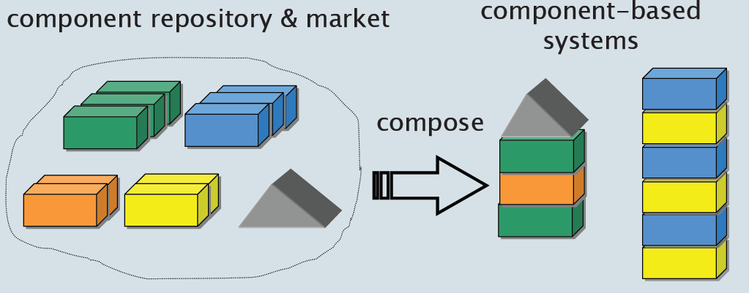
The CBD/CBSE is the Solution…
Systems should be assembled from existing components

Slide 15
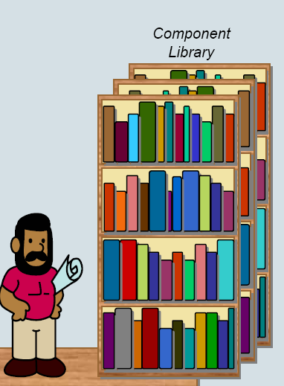
Why Components!!!
Following other engineering disciplines (civil and electrical), software engineering is looking to develop
A catalogue of software building blocks

Slide 16
Component-based Software Engineering

Slide 17
Component-based Software Engineering
Component analysis
Given the requirement specification
Search is made for components
Usually there is no exact match.
Requirement Modification
Requirements are analysed—using information of discovered components
If modifications are impossible— component analysis activity may be re-entered to search for alternate solution
System Design with Reuse
Frame work of system is designed or an existing frame work is reused.
Development and integration Software
Existing software /modified and newly developed components are integrated.

Slide 18
Component-based Software Engineering
Advantages
Reduce the amount of software to be developed
Reducing cost and risk
Faster delivery of software
Disadvantages
Requirement changes—may lead to a system that does not meet the real needs of users
Control over the system evolution is lost

Slide 19
Process Iteration
Two (related) process models
Incremental delivery
Spiral development

Slide 20
Incremental Approach
“The software specification, design and implementation are broken down into a series of increments that are each developed in turn”
System development is decomposed into increments and each delivers a proportion of the system.
Increments are developed based on their requirement priorities.

Slide 21
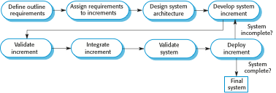
Incremental Development

Slide 22
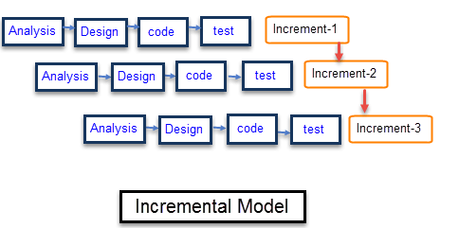

Slide 23
Incremental Delivery(Steps)
Customer identify—services provided by the system
Then identify which of the services are most important and which are least important
No of delivery increments are then identified with sub-set of the system functionality
Highest priority services delivered first
Requirements for the first increment are defined in detail
First Increment is developed and delivered ..customer can put into service.(Benefit for customer?)
During development ….further requirements analysis for later increments can take place

Slide 24
Incremental Model
Advantages:
Customer value can be delivered with each increment so system functionality is available earlier.
Early increments act as a prototype to help elicit requirements for later increments.
Lower risk of overall project failure.
The highest priority system services tend to receive the most testing.
Disadvantages:
Can be difficult to map the customer’s requirements onto increments of the right size.
Hard to identify common functions.

Slide 25
Spiral Model
The software process is represented as spiral, rather than a sequence of activities with some backtracking from one activity to another.
Each loop in spiral represents a phase of the software process
Innermost loop might be concerned with system feasibility
Next loop with requirements definition…next with system designed and so on.

Slide 26
Spiral Model of the Software Process

Slide 27
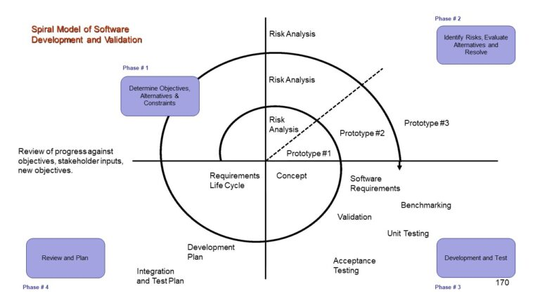
Spiral Model

Slide 28
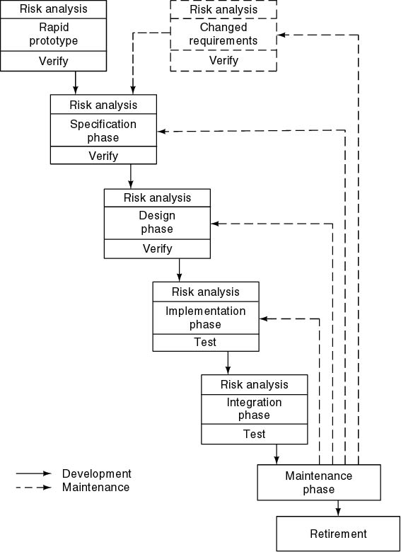
Spiral Model
Simplified form
Waterfall model plus risk analysis
Precede each phase by
Alternatives (build, reuse, buy, sub-contract)
Risk analysis (lack of experience, new technology, tight schedules)
Follow each phase by
Evaluation
Planning of next phase

Slide 29
Spiral Model Sectors
Each loop in spiral is split into four sectors
Objective setting
Specific objectives for that phase of the project are identified
Identify Constraints → on process & product.
Detail management plan is drawn up
Identify Project risks
Alternative strategies on these risks ...may be planned

Slide 30
Spiral Model Sectors
Risk assessment and reduction
For every identified risk → Detailed analysis is carried out
Steps are taken to reduce the risk
E.g.
Risk :
Requirements are inappropriate
Solution / Strategy
A prototype system may be developed
* Risks are
poorly understood requirements
poorly understood architecture
performance problems
important missing features

Slide 31
Spiral Model Sectors
Development and validation
A development model for the system is chosen which can be any of the generic models
For example, if user interface risks are dominant, an appropriate model may be “Evolutionary Prototyping”.
Selection of model will depend on your risk analysis.
Planning
The project is reviewed
Decision made whether to continue with a further loop of the spiral
If decided to continue, the next phase of the spiral is planned

Slide 32
Spiral Model(Example)
The evolution of Microsoft Operating System, Compilers and other operating systems.
For Large Scale projects

Slide 33
Chapter Reading
Chapter 2: Software Processes
Software Engineering by Ian Sommerville

